Slide 1

Big Jumps or Little Steps: Fighting Gerrymandering with Random Walks
Advisors: Dr. Scott Cook, Dr. Christopher Mitchell
Preston Ward, Suzie Tovar

Slide 2
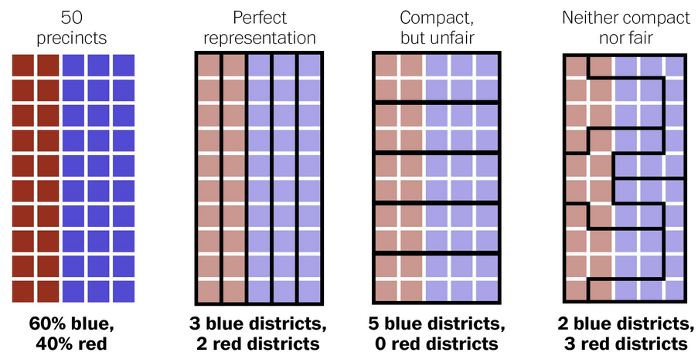
What is Gerrymandering?

Slide 3

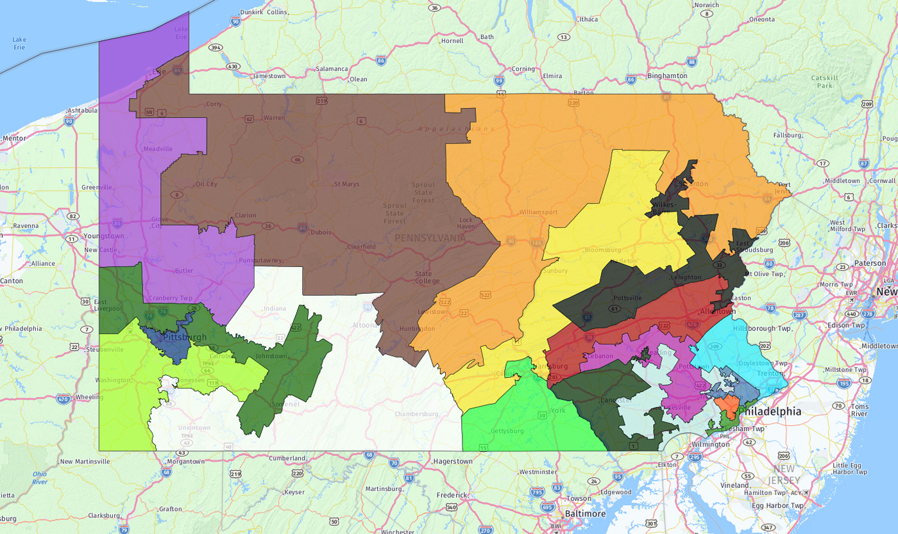
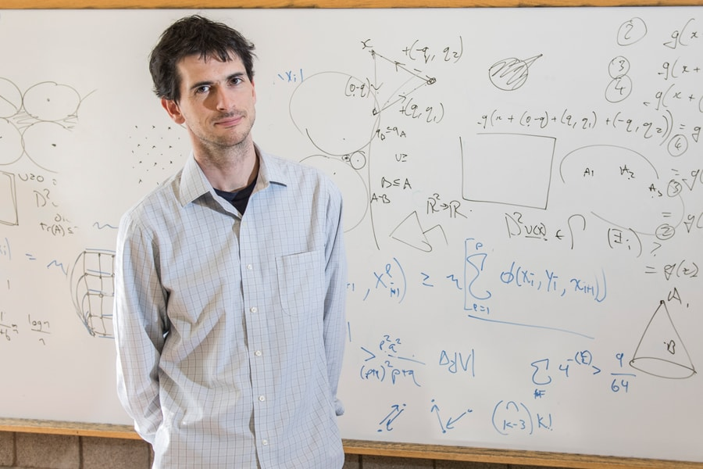
League of Women Voters of Pennsylvania v. Commonwealth of Pennsylvania

Slide 4
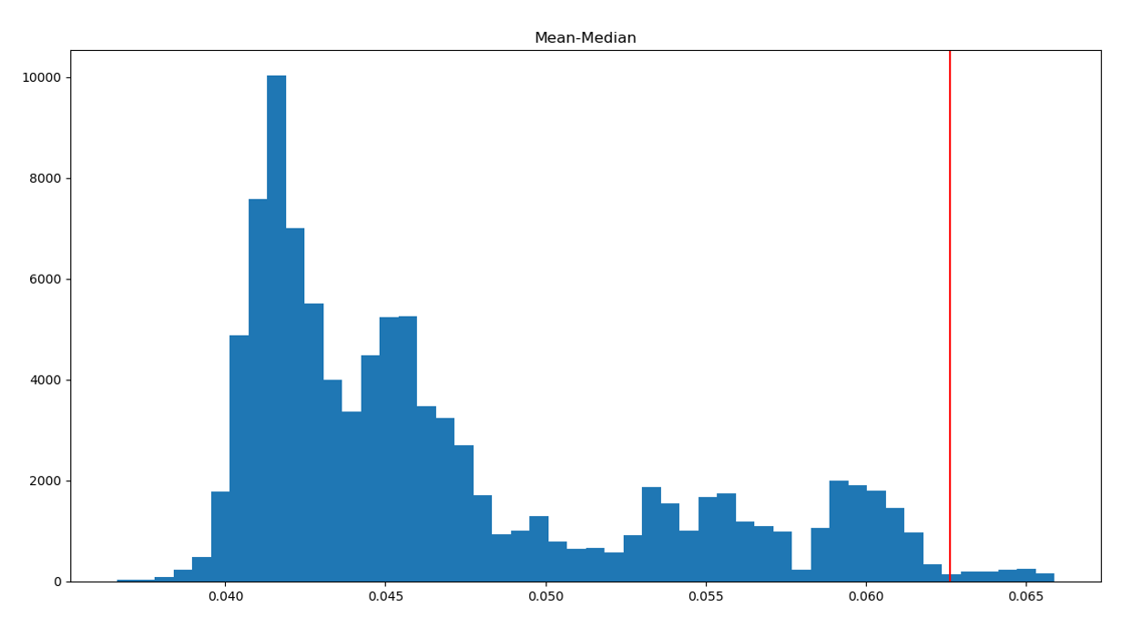
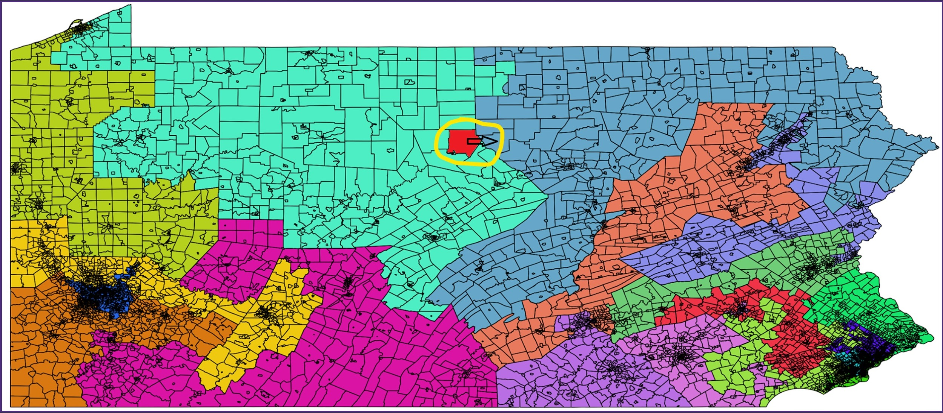
Original MCMC Results and GerryChain

Slide 5
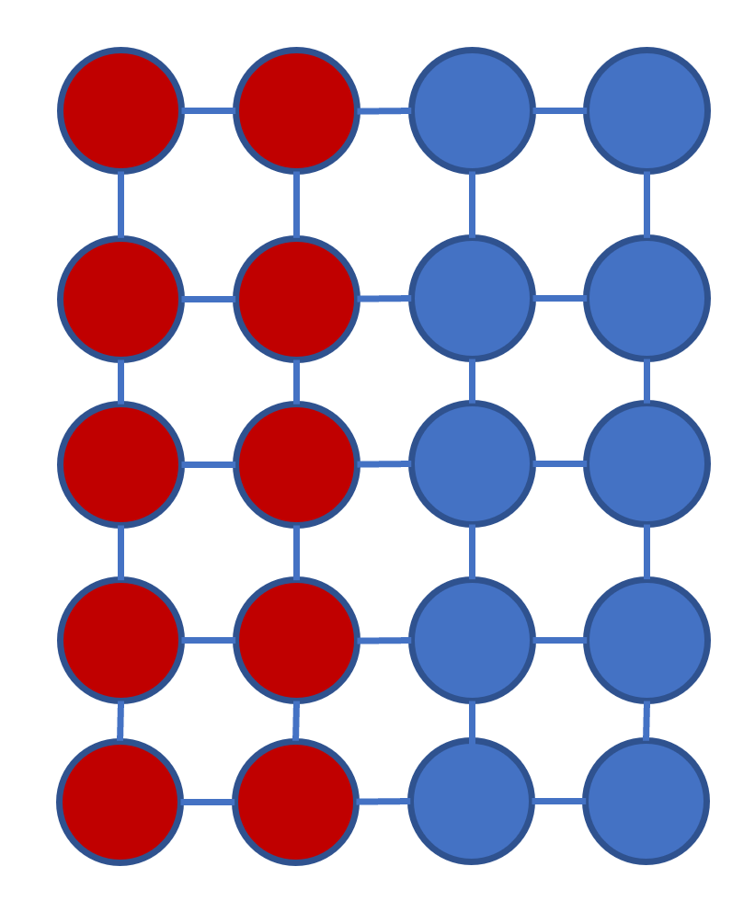
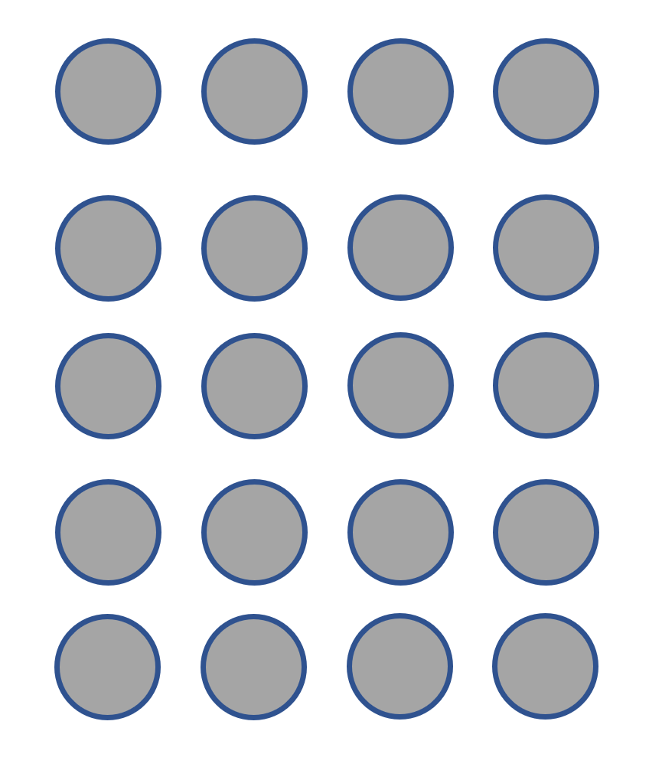
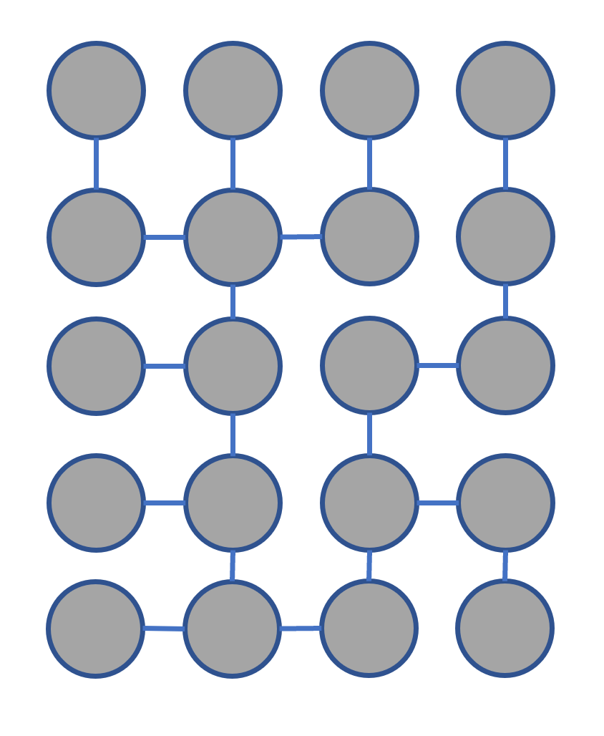
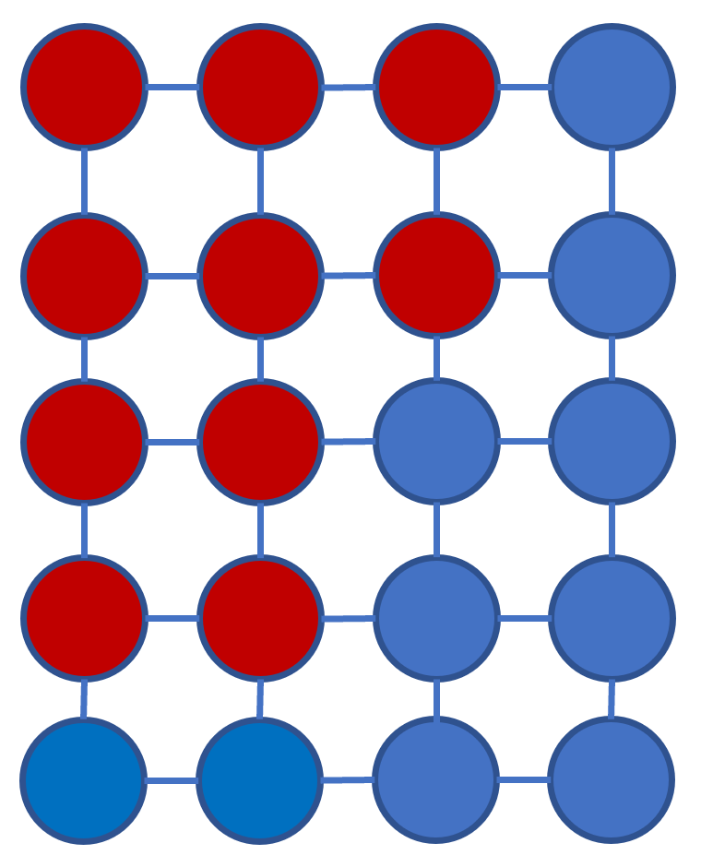
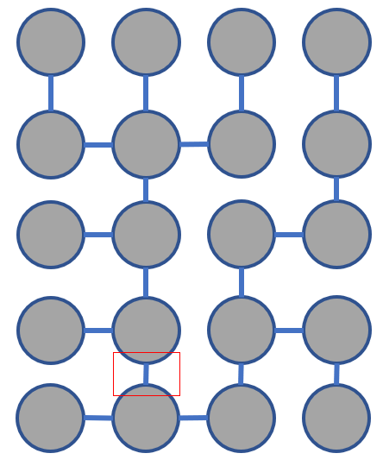
Recom Visualized

Slide 6
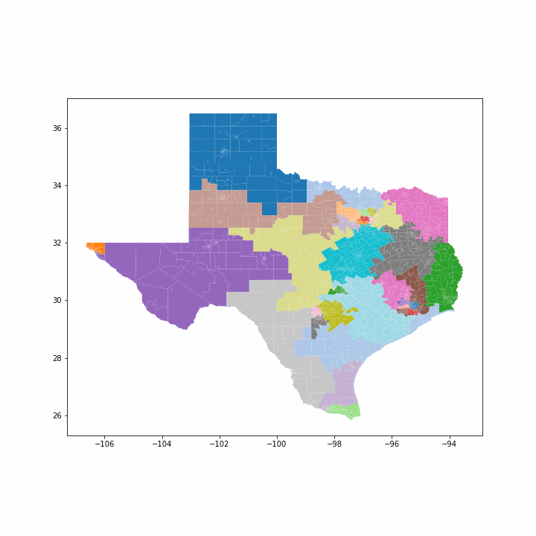
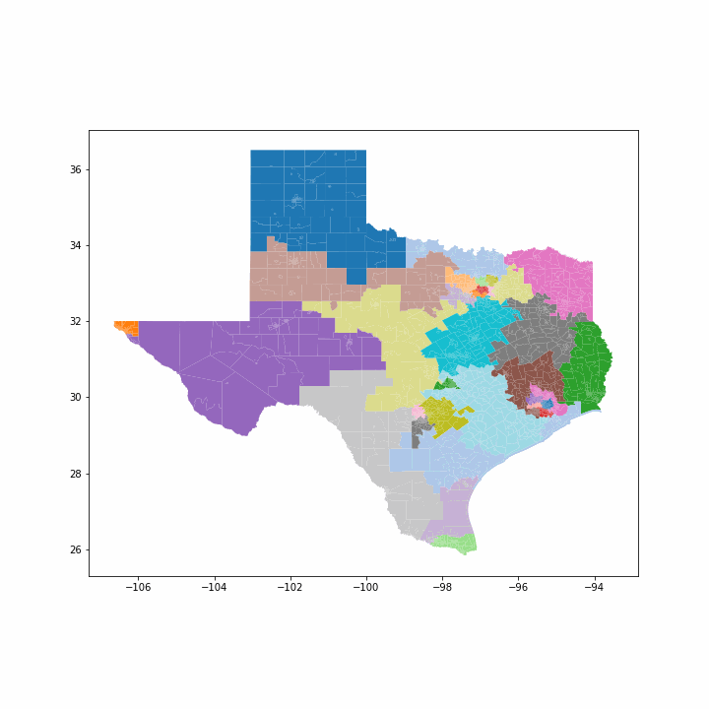
Single Flip VS Recom

Slide 7
Future Work :)
We have empirical evidence that the chain is converging, but we would really like to know if that is true. Our current approach is to construct a single value for each district and then take their average. Then, we compare those values for each step in the chain. If the values stop moving, this could be evidence of convergence.

Slide 8
Thank You
Casey Sutton, Tarleton State Univ, Math
Diana Dinh-Andrus, Tarleton State Univ, Math
Peter Hayes, Tarleton State Univ, Math
Mary Barker, Washington Univ in St. Louis
Joseph Brown, Financial Recovery Technologies
Dr. Scott Cook, Tarleton State Univ, Math
Dr. Anne Egelston, Tarleton State Univ, Political Science
Dr. Chris Mitchell, Tarleton State Univ, Math
Dr. Moon Duchin, Tufts Univ
Dr. Justin Solomon, MIT
Dr. Daryl DeFord, MIT
Dr. Rob Muth, Washington \& Jefferson College
Dr. Laurel Travis, Virginia Tech Univ
Betseygail Rand, Texas Lutheran University
Metric Geometry & Gerrymandering Group, https://www.mggg.org/

